Slide 1
Microsoft Word-The Basics

Slide 2

General Navigation
Tabs across top
Tabs open Ribbons
Ribbons contain Groups
Rulers across the top and along the side
Header
Document area

Slide 3
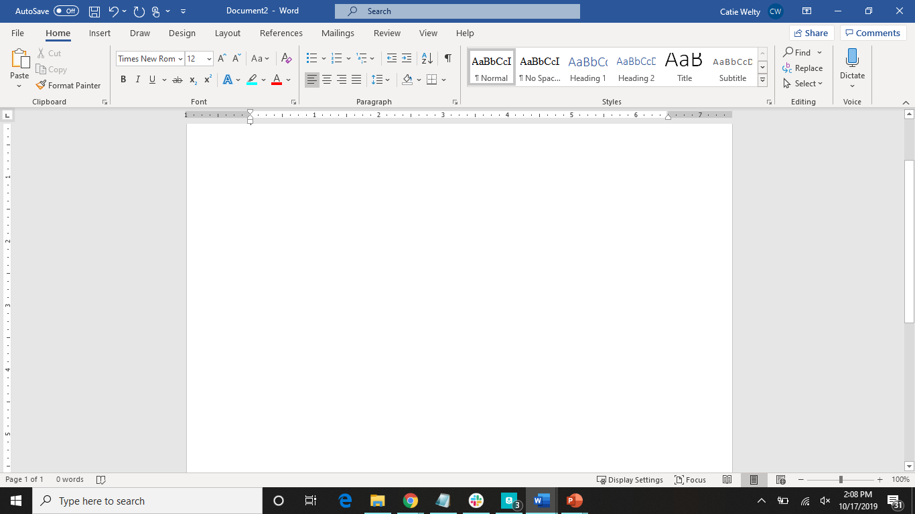

Tabs
Header Area
Ribbon
Groups
Document Area
Rulers

Slide 4
File Tab
Home-takes you to a place to make a new document or open other Word documents you have been working on
New-make new document from a template or blank
Open-look at the other Word documents saved to computer
Info-information about the current document and various tasks that can be done with it
Save-saves the current document
Save as-saves the current document after you select a place to save it to and a name for the document
Print-various things to adjust before printing
Share-only works if you have a OneDrive Account
Export-change the file type to preserve the document
Transform-turn document into a web page
Close-closes the document

Slide 5
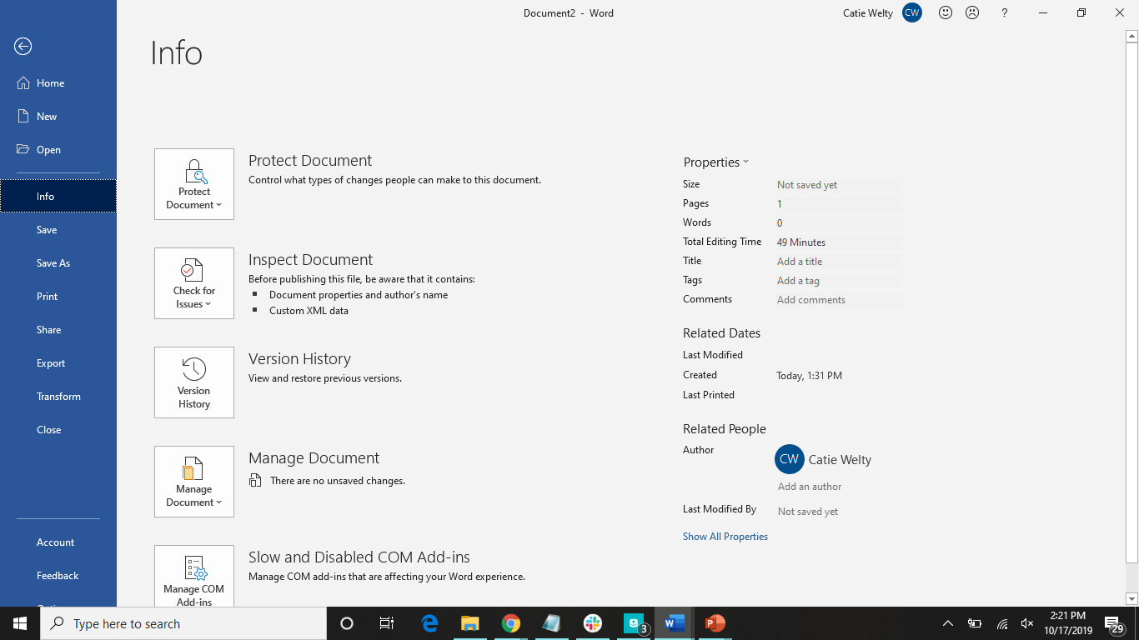

Slide 6
Print Preview/Printing
Click on the File tab
Click on the Print group
Look through the pages, and make adjustments based on how you want the document to be printed
Click on Print to print

Slide 7
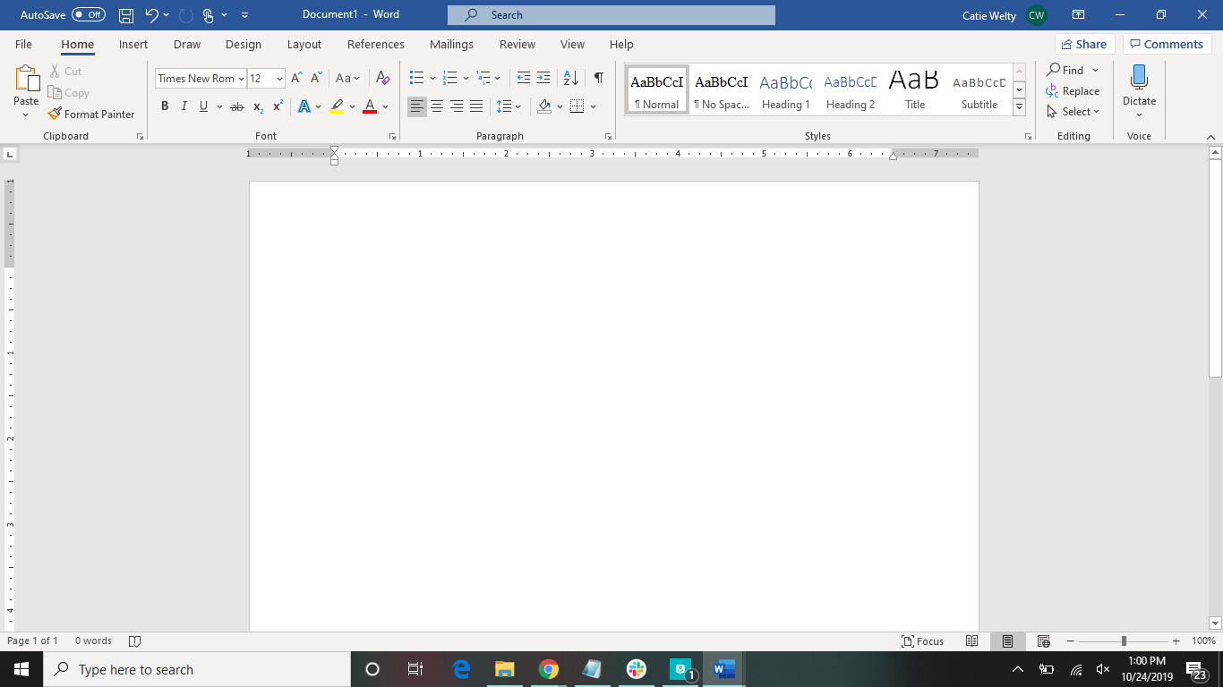
Step 1: Click Here

Slide 8
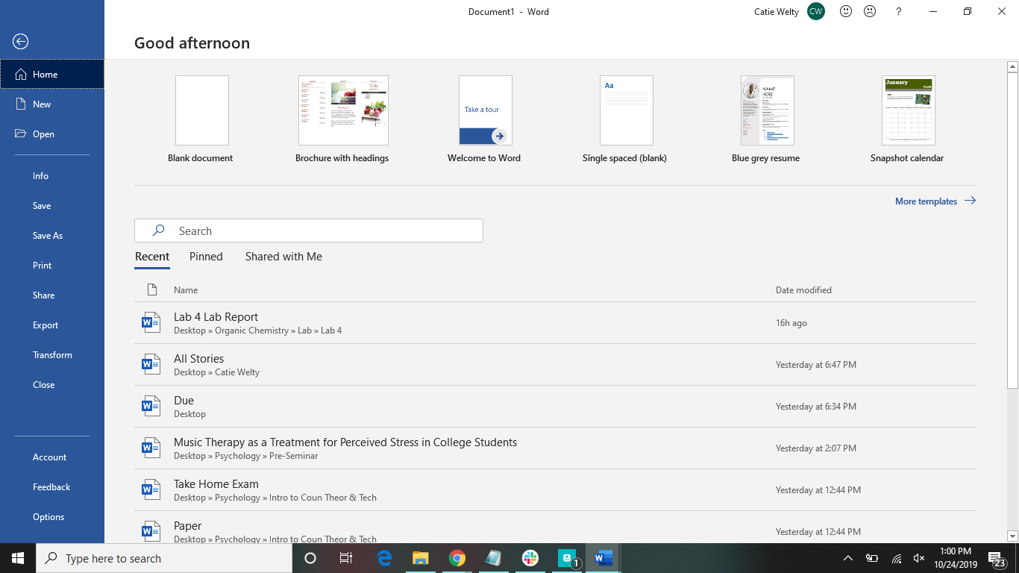
Step 2:
Click Here

Slide 9
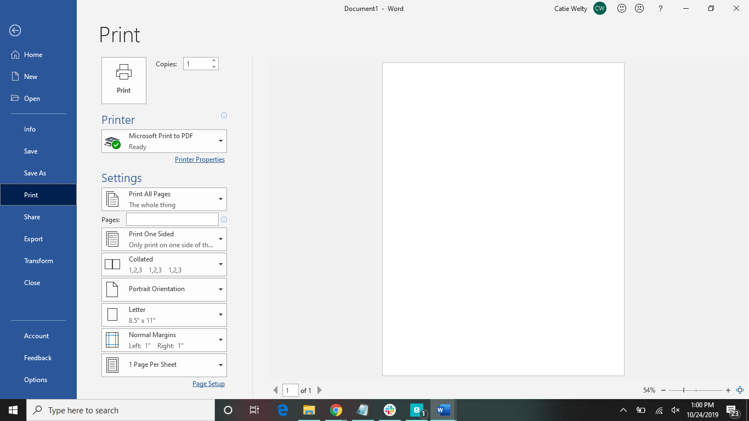
Click here to print
Select printer
Various different settings of printing
Use these arrows to look through each page of the document

Slide 10
Export to PDF
Option 1
Option 2
Go through the steps as if you are printing the document
Select “Microsoft Print to PDF” as the printer
Click print, and save the PDF where you would like it to be saved
Click on the File tab
Click on the Export group
Click on Create PDF/XPS
Save the PDF where you would like it to be saved
May be different if you are on a Mac

Slide 11
Click to print
Option 1
Make sure it says Print to PDF

Slide 12
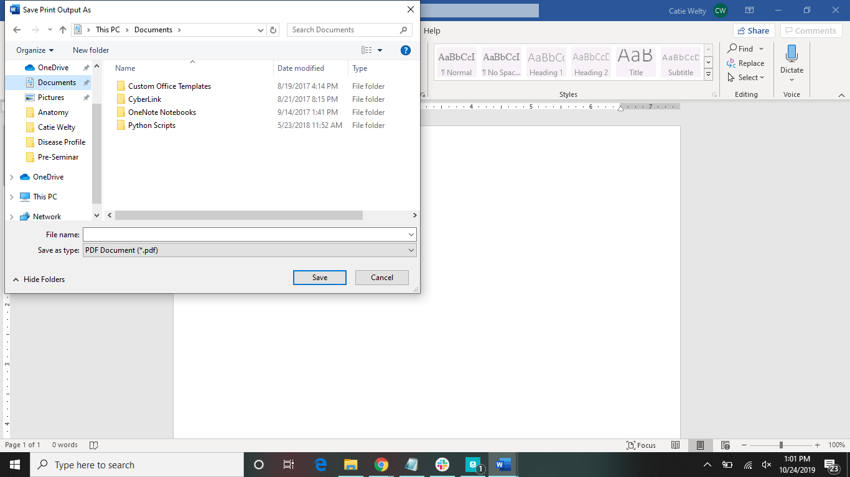
Option 1
Select where you would like it to be saved
Choose a name for the PDF

Slide 13
Option 2
Click Here

Slide 14
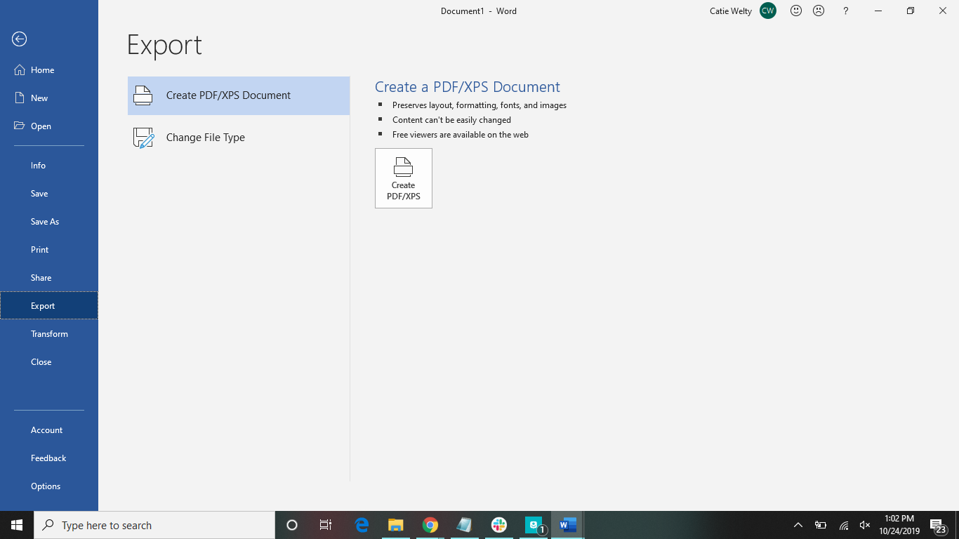
Option 2
Click Here

Slide 15
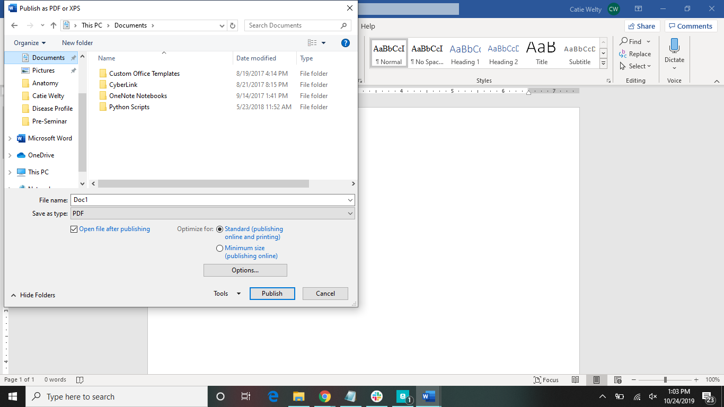
Option 2
Select where you would like it to be saved
Choose a name for the PDF

Slide 16
Home Tab
Clipboard group
Paste
Font group
Font type
Font size
Bold
Italicize
Underline
Strikethrough
Subscript
Superscript
Text effects and typography
Highlight
Font color
Change case
Paragraph group
Bullets
Numbers
Multilevel list
Align left
Center
Align right
Justify
Line & paragraph spacing
Shading
Borders
Sort
show/hide formatting symbols
Styles
Editing group
Find
Replace
Select
Voice group
Dictate

Slide 17


Slide 18
Insert Tab
Pages group
Cover page
Blank page
Page break
Tables
Illustrations group
Pictures
Online pictures
Shapes
Icons
3D models
SmartArt
Chart
Screenshot
Add-ins group
Get add-ins
My add-ins
Wikipedia
Media group
Online video
Comments
Header & footer group
Header
Footer
Page number
Text group
Text box
Explore quick parts
Insert word art
Add a drop ap
Add a signature line
Insert date and time
Object
Symbols group
Equation
Symbol

Slide 19
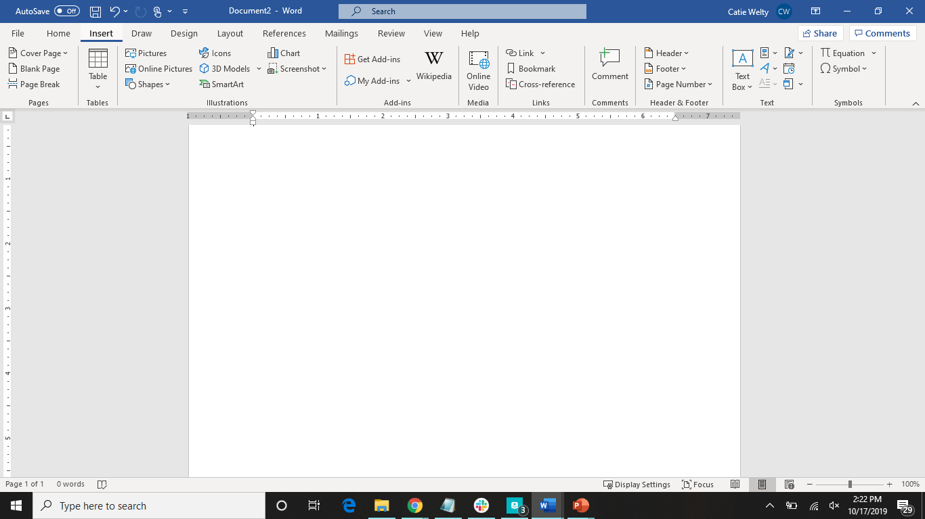

Slide 20
Draw Tab
Tools group
Draw
Eraser
Pens
Convert group
Ink editor
Ink to shape
Ink to math
Insert group
Drawing canvas
Replay group
Ink replay

Slide 21
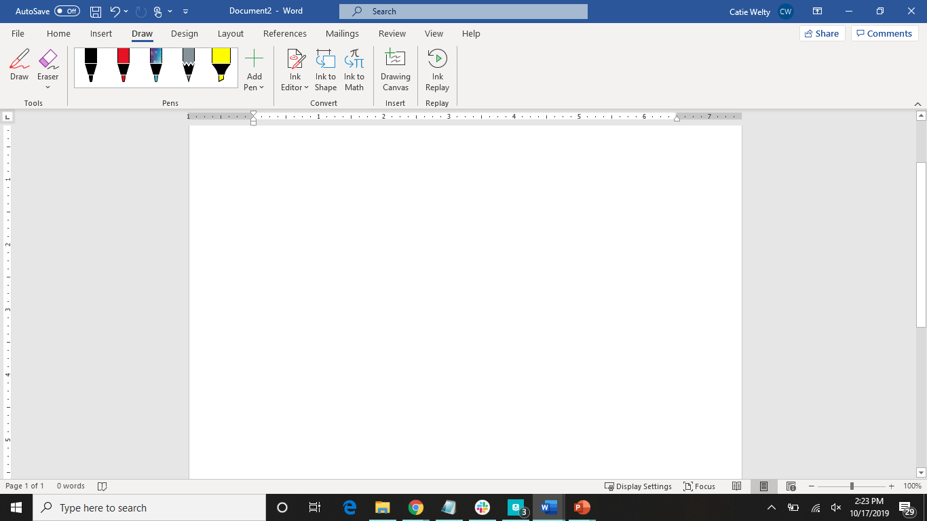

Slide 22
Design Tab
Document formatting
Colors
Fonts
Paragraph spacing
Effects
Set as default
Page background
Watermark
Page color
Page borders

Slide 23
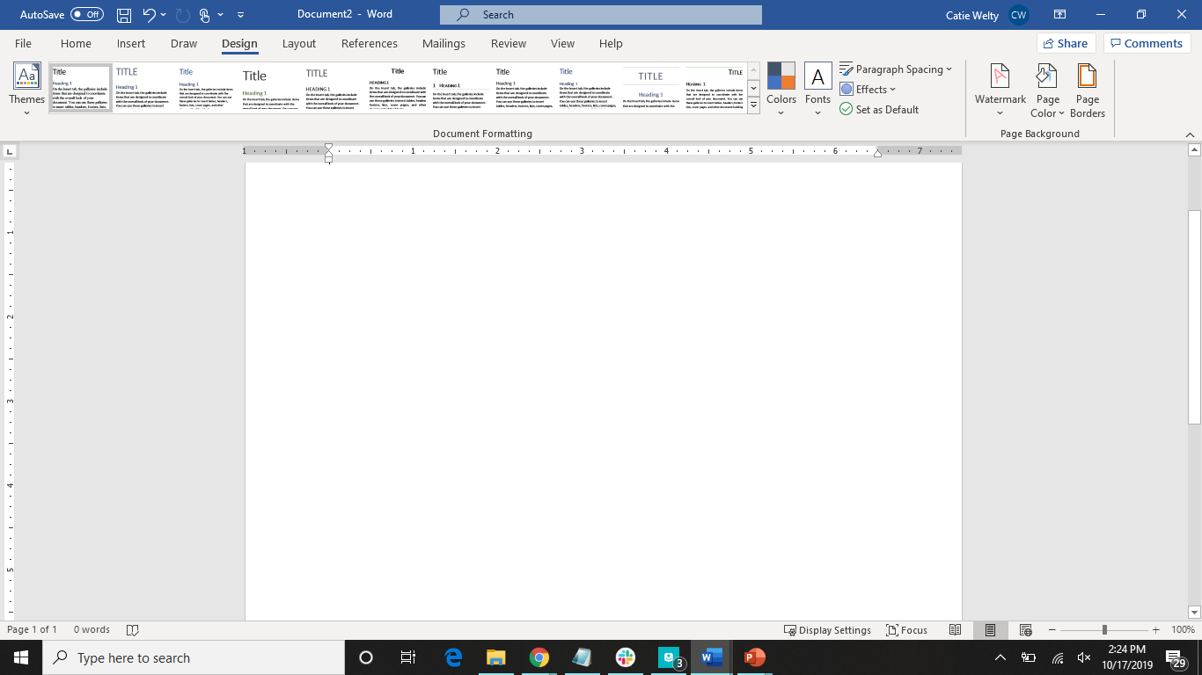

Slide 24
Layout Tab
Page setup group
Margins
Orientation
Size
Columns
Breaks
Line numbers
Hyphenation
Paragraph group
Indent
Spacing
Arrange group
Position
Wrap text
Bring forward
Send backward
Selection pane
Align
Group
Rotate

Slide 25
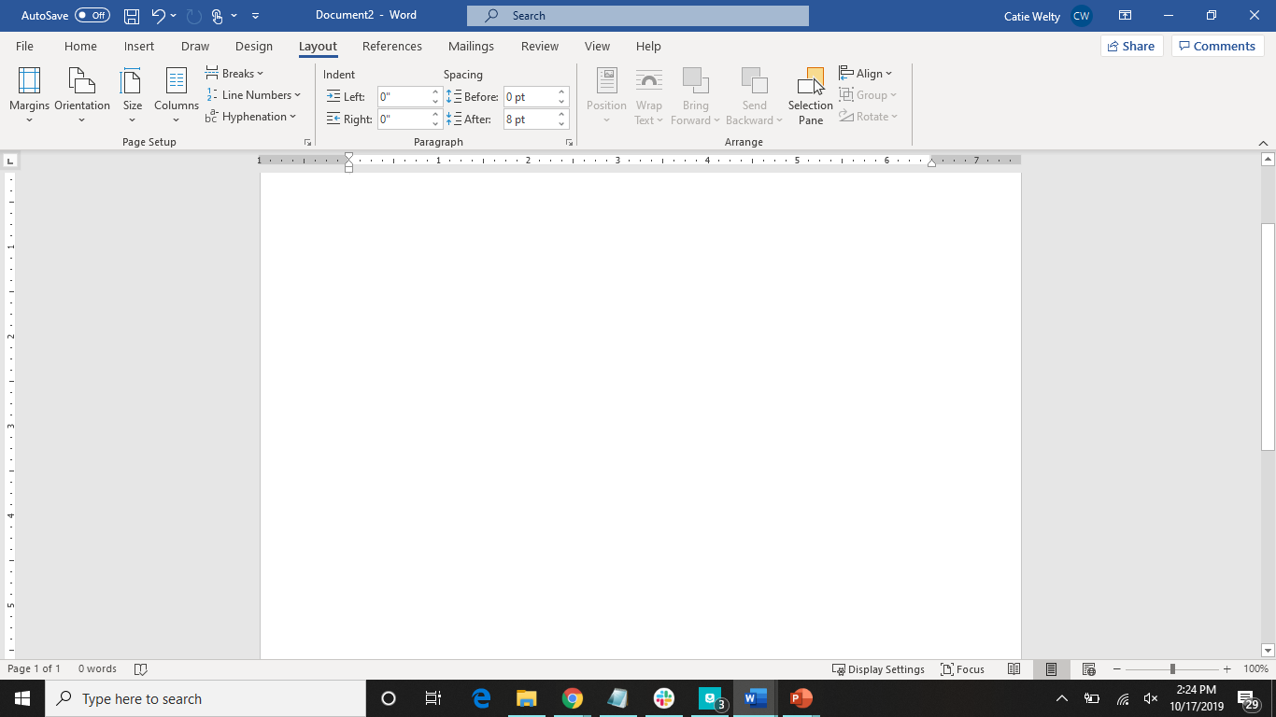

Slide 26
References Tab
Table of contents
Add text
Update table
Footnotes
Insert footnote
Insert endnote
Next footnote
Show notes
Research group
Smart lookup
Researcher
Citations & bibliography group
Insert citation
Manage sources
Style
Bibliiography
Captions group
Insert caption
Insert table of figures
Update table
cross-reference
Index group
Mark entry
Insert index
Update index
Table of authorities
Mark citation
Insert table of authorities
Update table of authorities

Slide 27
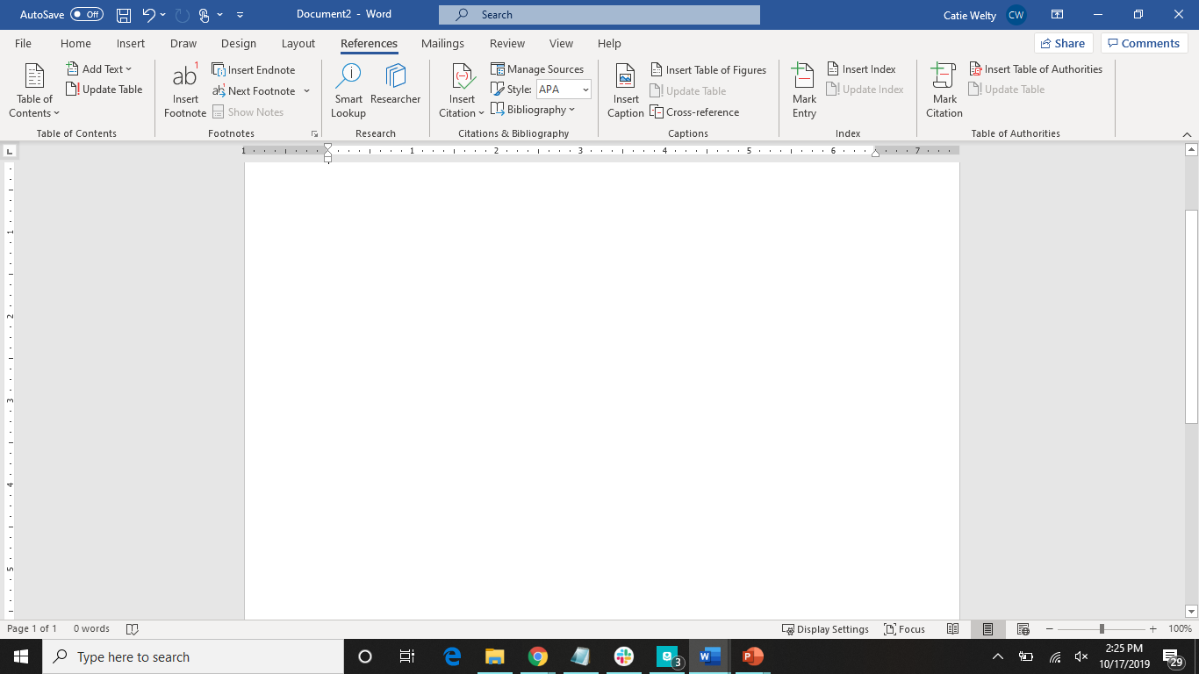

Slide 28
Mailings Tab
Create group
Envelopes
Labels
Start mail merge
Select recipients
Edit recipients list
Write & insert fields
Highlight merge fields
Address book
Greeting line
Insert merge field
Rules
Match fields
Update labels
Preview results
Find recipient
Check for errors
Finish & merge

Slide 29
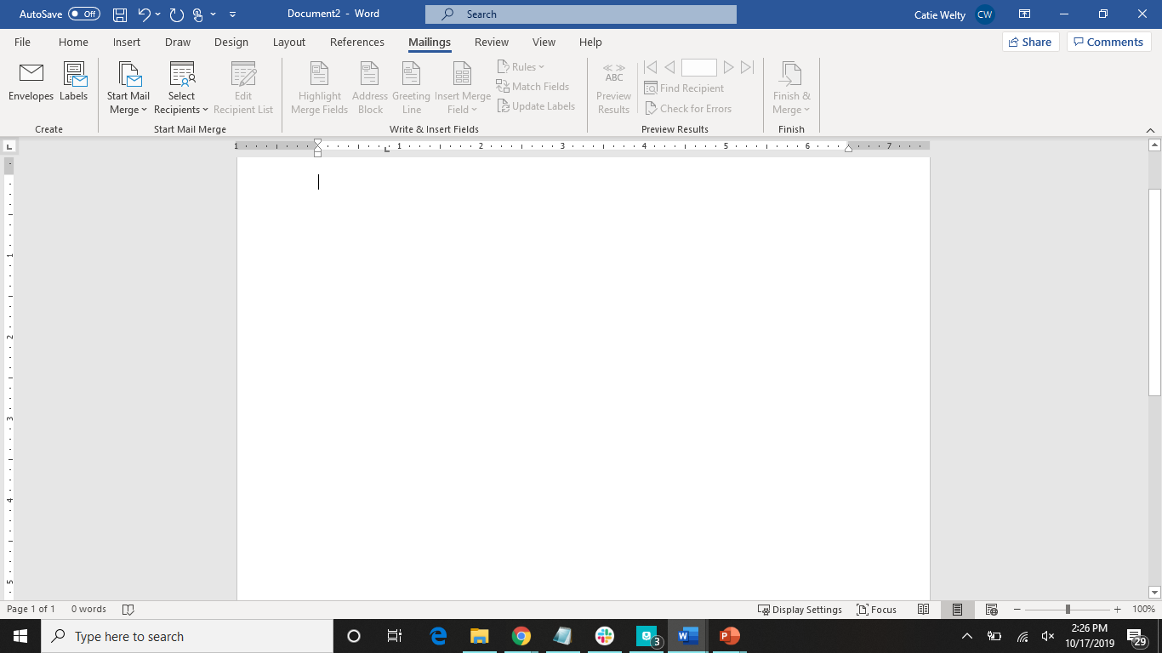

Slide 30
Review Tab
Proofing group
Check document
Thesaurus
Word count
Speech group
Read aloud
Accesibility group
Check accessibility
Language group
Translate
Language
Comments group
New comment
Delete
Previous
Next
Show comments
Tracking group
Track changes
Display for review
Show markup
Reviewing pane
Changes group
Accept
Reject and move to next
Previous change
Next change
Compare group
Compare
Combine
Protect group
Block authors
Restrict authors
Ink group
Hide ink
Resume group
Resume assistant
OneNote group
linked notes

Slide 31
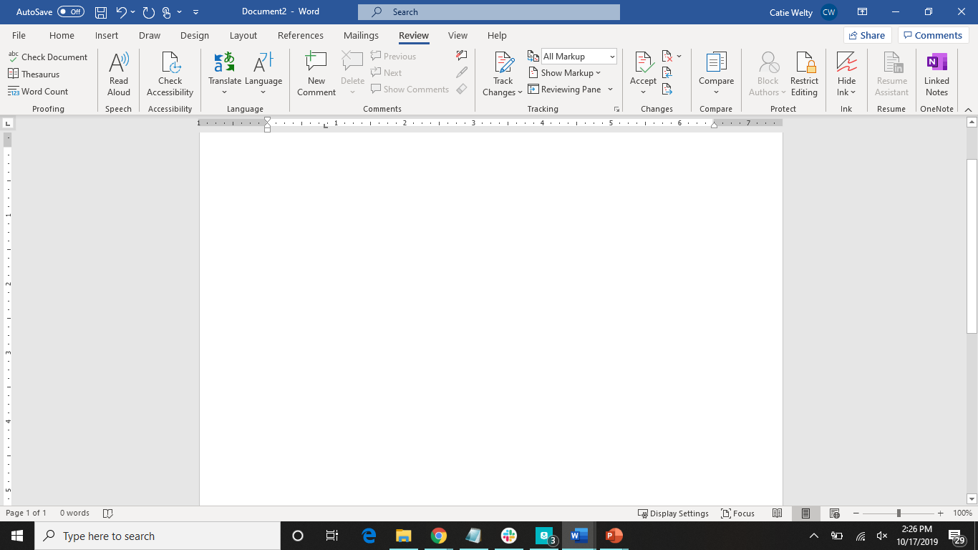

Slide 32
View Tab
Views group
Read mode
Print layout
Web layout
Outline
Draft
Immersive group
Focus
Learning tools
Page movement group
Vertical
Side to side
Show group
Ruler
Gridlines
Navigation pane
Zoom group
Zoom
100%
One page
Multiple pages
Page width
Window group
New window
Arrange all
Split
View side by side
Synchronous scrolling
Reset window position
Switch windows
Macros group
View macros
Record macro
Pause recording
SharePoint
Properties

Slide 33
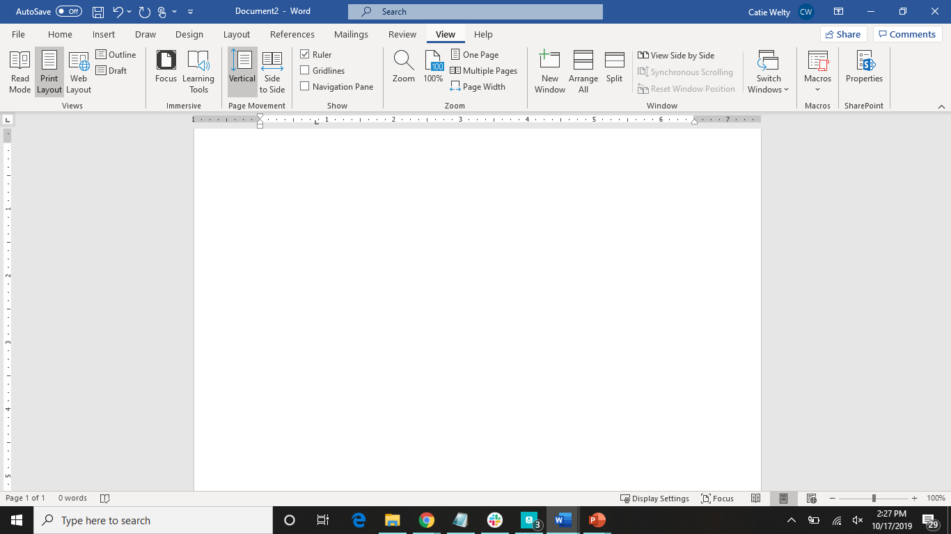

Slide 34
Help Tab
Help
Contact support
Feedback
Show training
What’s new

Slide 35
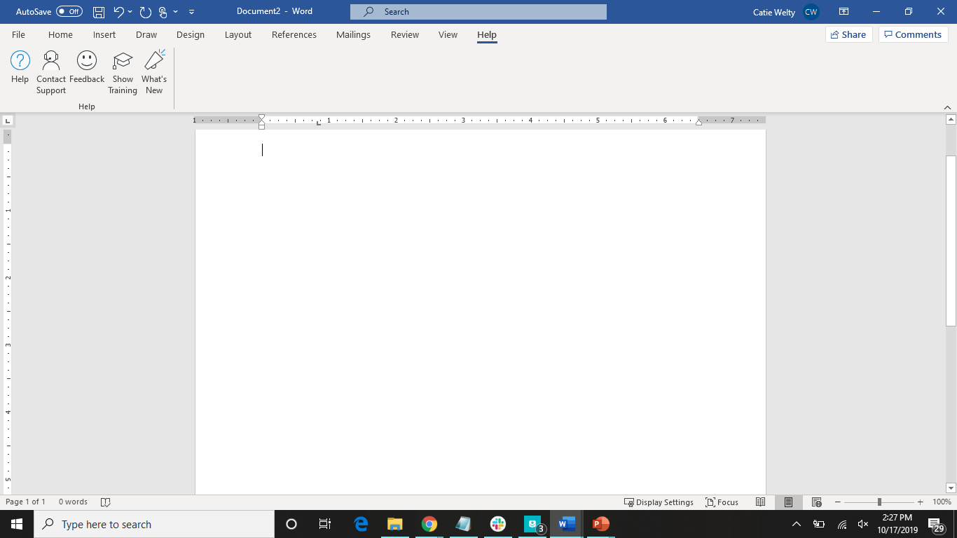

Slide 36
How to Add a Header or Footer
Select insert
Select header or footer
Choose one of the built-in templates displayed
Place cursor in the header or footer; add the text you want
When done, select close header/footer
To make more edits, double click in header/footer
Click on different first page if you want the first page to look different

Slide 37
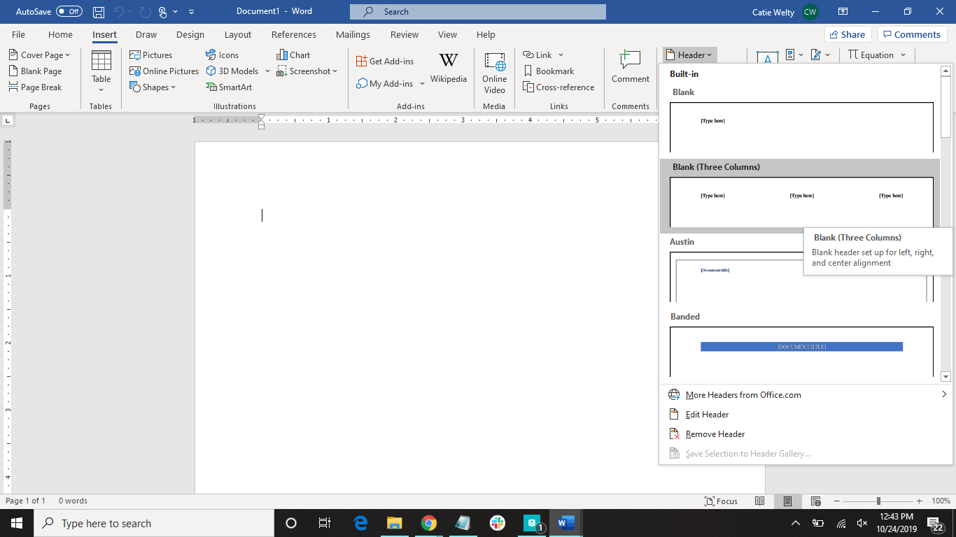
Step 1
Step 2
Step 3

Slide 38
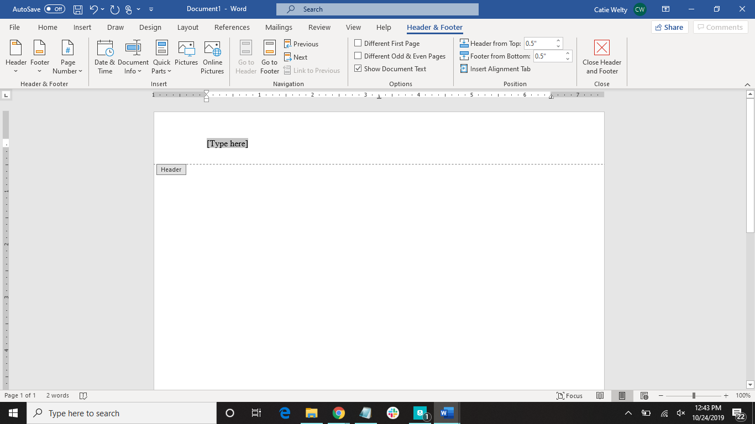
Click here to close
Type your header in here

Slide 39
Have more questions?
Email us at ccla@doane.edu or come visit us in Communications 188D from 9am to 5pm.
You can also visit our website at https://www.doane.edu/ccla

Slide 40
Sources
Microsoft Word Help and Support. (2019, June 30). Retrieved from https://www.computerhope.com/software/msword.htm

Slide 41

Please provide some feedback on the presentation by following the QR Code below.

